Slide 1
Computational Physics
(Lecture 21)
PHY4061

Slide 2
It's not difficult to find ideas which achieve accuracies in the 20 to 50 percent range.
If you work a bit harder you can get up over 50 percent. But to get much higher accuracies it helps to use established machine learning algorithms.
Let's try using one of the best known algorithms, the support vector machine or SVM.
If we run scikit-learn's SVM classifier using the default settings, then it gets 9,435 of 10,000 test images correct.
The current (2013) record is classifying 9,979 of 10,000 images correctly. This was done by Li Wan, Matthew Zeiler, Sixin Zhang, Yann LeCun, and Rob Fergus.

Slide 3
Toward deep learning
Can we find some way to understand the principles by which our network is classifying handwritten digits? And, given such principles, can we do better?

Slide 4
Suppose that a few decades hence neural networks lead to artificial intelligence (AI).
Will we understand how such intelligent networks work?
Perhaps the networks will be opaque to us, with weights and biases we don't understand, because they've been learned automatically.
In the early days of AI research people hoped that the effort to build an AI would also help us understand the principles behind intelligence and, maybe, the functioning of the human brain. But perhaps the outcome will be that we end up understanding neither the brain nor how artificial intelligence works!

Slide 5
Suppose we want to determine whether an image shows a human face or not
We could attack this problem the same way we attacked handwriting recognition
  with the output from the network a single neuron indicating either "Yes, it's a face" or "No, it's not a face".

Slide 6
Suppose we're not using a learning algorithm.
To design a network by hand, choosing appropriate weights and biases.
How might we go about it?
  a heuristic we could use is to decompose the problem into sub-problems: does the image have an eye in the top left? Does it have an eye in the top right? Does it have a nose in the middle? Does it have a mouth in the bottom middle? Is there hair on top? And so on.

Slide 7
Still, the heuristic suggests that if we can solve the sub-problems using neural networks, then perhaps we can build a neural network for face-detection,
  by combining the networks for the sub-problems.
Here's a possible architecture, with rectangles denoting the sub-networks. Note that this isn't intended as a realistic approach to solving the face-detection problem; rather, it's to help us build intuition about how networks function.

Slide 8
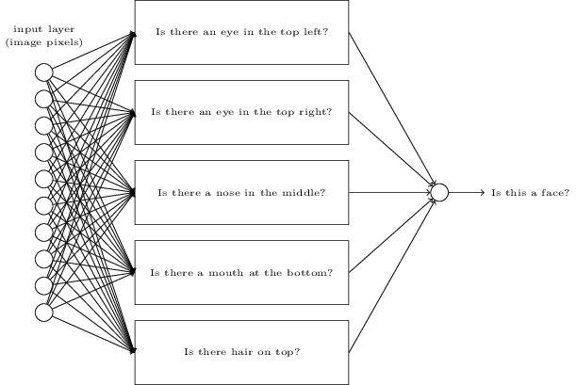

Slide 9
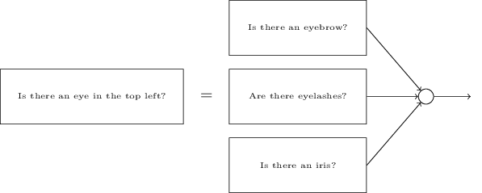

Slide 10
Those questions too can be broken down, further and further through multiple layers.
Ultimately, we'll be working with sub-networks that answer questions so simple they can easily be answered at the level of single pixels.
Those questions might, for example, be about the presence or absence of very simple shapes at particular points in the image. Such questions can be answered by single neurons connected to the raw pixels in the image.

Slide 11
The end result is a network which breaks down a very complicated question - does this image show a face or not - into very simple questions answerable at the level of single pixels.
It does this through a series of many layers, with early layers answering very simple and specific questions about the input image, and later layers building up a hierarchy of ever more complex and abstract concepts.
Networks with this kind of many-layer structure - two or more hidden layers - are called deep neural networks.

Slide 12
Researchers in the 1980s and 1990s tried using stochastic gradient descent and backpropagation to train deep networks.
Unfortunately, except for a few special architectures, they didn't have much luck. The networks would learn, but very slowly, and in practice often too slowly to be useful.

Slide 13
Since 2006, a set of techniques has been developed that enable learning in deep neural nets.
  based on stochastic gradient descent and backpropagation, but also introduce new ideas.
  These techniques have enabled much deeper (and larger) networks to be trained - people now routinely train networks with 5 to 10 hidden layers.
  And, it turns out that these perform far better on many problems than shallow neural networks, i.e., networks with just a single hidden layer.
  The reason, of course, is the ability of deep nets to build up a complex hierarchy of concepts.

Slide 14
  It's a bit like the way conventional programming languages use modular design and ideas about abstraction to enable the creation of complex computer programs. Comparing a deep network to a shallow network is a bit like comparing a programming language with the ability to make function calls to a stripped down language with no ability to make such calls.
  Abstraction takes a different form in neural networks than it does in conventional programming, but it's just as important.

Slide 15
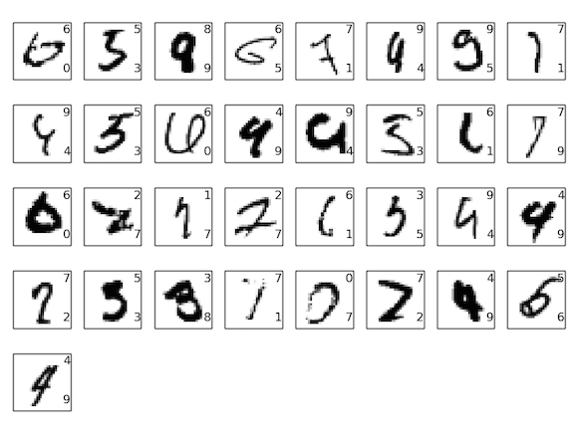
Deep learning
With the deep learning network, the improved system will classify 9,967/10000 correctly. Note that the correct classification is in the top right; our program's classification is in the bottom right:

Slide 16
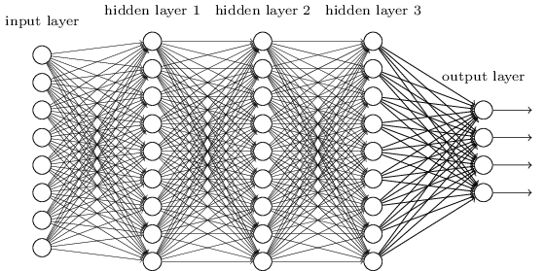
Introducing convolutional networks

Slide 17
Strange to use networks with fully-connected layers to classify images.
  Such a network architecture does not take into account the spatial structure of the images.
  Treats input pixels which are far apart and close together on exactly the same footing.
  Can we use an architecture which tries to take advantage of the spatial structure?

Slide 18
The origins of convolutional neural networks
  in 1970s.
The seminal paper establishing the modern subject of convolutional networks was a 1998 paper, "Gradient-based learning applied to document recognition", by Yann LeCun, Léon Bottou, Yoshua Bengio, and Patrick Haffner.

Slide 19
Convolutional neural networks use three basic ideas: local receptive fields, shared weights, and pooling.

Slide 20
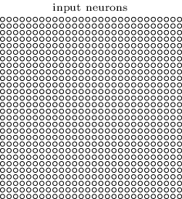
Local receptive fields:
  In the fully-connected layers, the inputs were depicted as a vertical line of neurons.
  In a convolutional net, it'll help to think instead of the inputs as a 28×28 square of neurons, whose values correspond to the 28×28 pixel intensities we're using as inputs:

Slide 21
As per usual, we'll connect the input pixels to a layer of hidden neurons. But we won't connect every input pixel to every hidden neuron. Instead, we only make connections in small, localized regions of the input image.
  This is a local approximation.

Slide 22
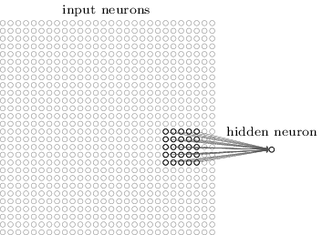
To be more precise, each neuron in the first hidden layer will be connected to a small region of the input neurons, say, for example, a 5×5 region, corresponding to 25 input pixels. So, for a particular hidden neuron, we might have connections that look like this:

Slide 23
That region in the input image is called the local receptive field for the hidden neuron.
It's a little window on the input pixels.
Each connection learns a weight.
And the hidden neuron learns an overall bias as well. You can think of that particular hidden neuron as learning to analyze its particular local receptive field.

Slide 24
We then slide the local receptive field across the entire input image.
For each local receptive field, there is a different hidden neuron in the first hidden layer.

Slide 25
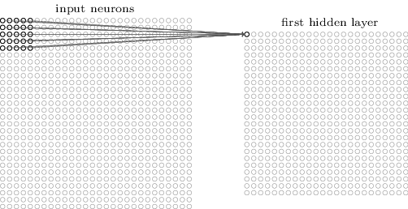
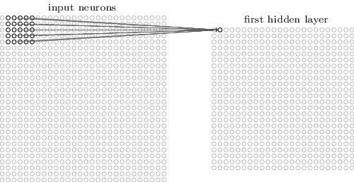
What’s the size of the first hidden layer?
In fact, sometimes a different stride length is used.

Slide 26
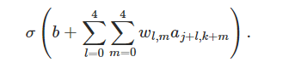
Shared weights and biases
use the same weights and bias for each of the 24×24 hidden neurons.
for the j,kth hidden neuron, the output is:
    σ is the neural activation function. b is the shared value for the bias. w_{l,m} is a 5×5 array of shared weights. And a_{x,y} to denote the input activation at position x,y.

Slide 27
All the neurons in the first hidden layer detect exactly the same feature
  feature detected by a hidden neuron as the kind of input pattern that will cause the neuron to activate: it might be an edge in the image, for instance, or maybe some other type of shape.
To see why this makes sense, suppose the weights and bias are such that the hidden neuron can pick out, say, a vertical edge in a particular local receptive field.

Slide 28
That ability: likely to be useful at other places in the image.
Useful to apply the same feature detector everywhere in the image.
Slightly more abstract terms:
  convolutional networks are well adapted to the translation invariance of images: move a picture of a cat (say) a little ways, and it's still an image of a cat
    So MNIST has less translation invariance (why?) than images found "in the wild", so to speak. Still, features like edges and corners are likely to be useful across much of the input space.

Slide 29
map from the input layer to the hidden layer a feature map.
  weights defining the feature map the shared weights.
Bias defining the feature map in this way the shared bias.
The shared weights and bias are often said to define a kernel or filter.

Slide 30
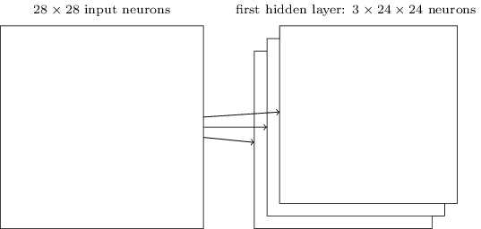
To do image recognition we'll need more than one feature map. And so a complete convolutional layer consists of several different feature maps

Slide 31
Each feature map is defined by a set of 5×5 shared weights, and a single shared bias.
The result is that the network can detect 3 different kinds of features, with each feature being detectable across the entire image.

Slide 32
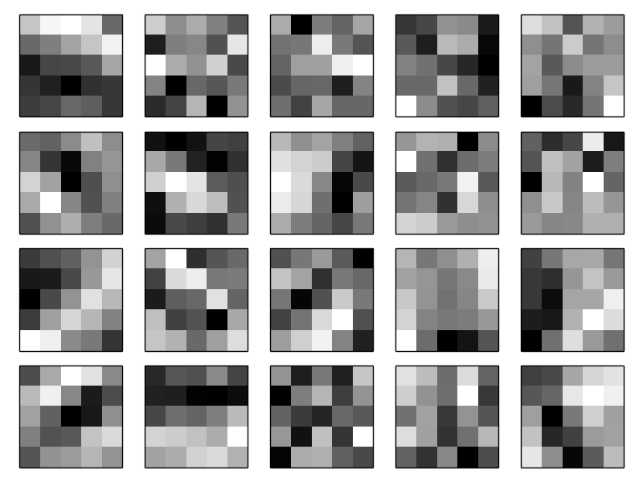

Slide 33
The 20 images correspond to 20 different feature maps (or filters, or kernels).
Each map is represented as a 5×5 block image, corresponding to the 5×5 weights in the local receptive field.
Whiter blocks mean a smaller (typically, more negative) weight, so the feature map responds less to corresponding input pixels.
Darker blocks mean a larger weight, so the feature map responds more to the corresponding input pixels. Very roughly speaking, the images above show the type of features the convolutional layer responds to.

Slide 34
spatial structure here beyond what we'd expect at random: many of the features have clear sub-regions of light and dark.
That shows our network really is learning things related to the spatial structure.
It's difficult to see what these feature detectors are learning.

Slide 35
A lot of work on better understanding the features learnt by convolutional networks.
a paper: Visualizing and Understanding Convolutional Networks by Matthew Zeiler and Rob Fergus (2013).

Slide 36
A big advantage of sharing weights and biases is that it greatly reduces the number of parameters involved in a convolutional network.

Slide 37
Pooling layers
In addition to the convolutional layers just described, convolutional neural networks also contain pooling layers. Pooling layers are usually used immediately after convolutional layers. What the pooling layers do is simplify the information in the output from the convolutional layer.

Slide 38
pooling layer takes each feature map output from the convolutional layer and prepares a condensed feature map.
For instance, each unit in the pooling layer may summarize a region of (say) 2×2 neurons in the previous layer.
As a concrete example, one common procedure for pooling is known as max-pooling.
In max-pooling, a pooling unit simply outputs the maximum activation in the 2×2 input region, as illustrated in the following diagram:

Slide 39
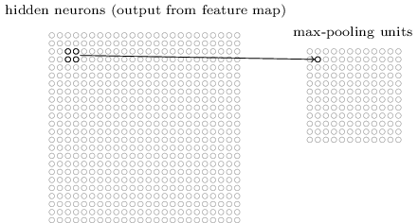

Slide 40
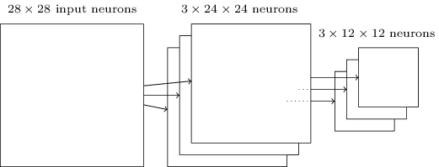

Slide 41
max-pooling as a way for the network to ask whether a given feature is found anywhere in a region of the image.
It then throws away the exact positional information.
The intuition is that once a feature has been found, its exact location isn't as important as its rough location relative to other features.
A big benefit is that there are many fewer pooled features, and so this helps reduce the number of parameters needed in later layers.

Slide 42
Another common approach is known as L2 pooling.
Take the square root of the sum of the squares of the activations in the 2×2 region.
While the details are different, the intuition is similar to max-pooling: L2 pooling is a way of condensing information from the convolutional layer.

Slide 43
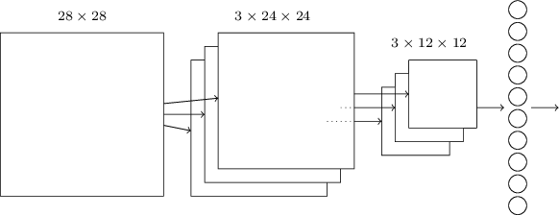

Slide 44
Using an ensemble of networks: An easy way to improve performance still further is to create several neural networks, and then get them to vote to determine the best classification.
Suppose, for example, that we trained 5 different neural networks using the prescription above, with each achieving accuracies near to 99.6 percent.
Even though the networks would all have similar accuracies, they might well make different errors, due to the different random initializations. It's plausible that taking a vote amongst our 5 networks might yield a classification better than any individual network.

Slide 45
Will neural networks and deep learning soon lead to artificial intelligence?
Conway's law:
Any organization that designs a system... will inevitably produce a design whose structure is a copy of the organization's communication structure.

Slide 46
So, for example, Conway's law suggests that the design of a Boeing 747 aircraft will mirror the extended organizational structure of Boeing and its contractors at the time the 747 was designed.

Slide 47
This is a common pattern
The fields start out monolithic, with just a few deep ideas.
Early experts can master all those ideas.
But as time passes that monolithic character changes.
We discover many deep new ideas, too many for any one person to really master.
As a result, the social structure of the field re-organizes and divides around those ideas.

Slide 48
Instead of a monolith, we have fields within fields within fields, a complex, recursive, self-referential social structure, whose organization mirrors the connections between our deepest insights.
And so the structure of our knowledge shapes the social organization of science.
But that social shape in turn constrains and helps determine what we can discover. This is the scientific analogue of Conway's law.

Slide 49
how powerful a set of ideas are associated to deep learning, according to this metric of social complexity?
How powerful a theory will we need, in order to be able to build a general artificial intelligence?

Slide 50
according to the metric of social complexity, deep learning is, if you'll forgive the play on words, still a rather shallow field. It's still possible for one person to master most of the deepest ideas in the field.

Slide 51
It's going to take many, many deep ideas to build an AI.
And so Conway's law suggests that
  to get to such a point we will necessarily see the emergence of many interrelating disciplines,
  with a complex and surprising structure mirroring the structure in our deepest insights.

